Slide 1
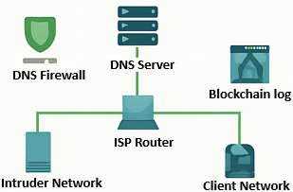





Blockchain-Secured DNS Infrastructure
Simulating DNS Integrity Using ACLs and Blockchain Validation in Cisco Packet Tracer
Project Scope
System Architecture
Testing
Secure DNS using ACL’s and simulated blockchain validation Prevent DNS spoofing and hijacking attempts Use Cisco Packet Tracer to model DNSSEC behavior
Key Features Testing
Ping/HTTP tests confirm connectivity ACL rules restrict attacker access Blockchain log validated DNS entries
Key Features Testing
Conclusion
Objectives
ACLs and blockchain simulation improved DNS security Successfully demonstrated layered validation in Packet Tracer Prepared environment for future DNS spoofing defense
Segment network into Victim, ISP, and Intruder Configure ACLs and routing
ACL-based traffic filtering
Blockchain log
for DNS integrity
Ping/HTTP tests confirm connectivity
Blockchain hash verification manually confirms DNS responses
Team Members
Tools Used: Cisco Packet Tracer
Tirth Patel Filip Mangoski Sheila Maita

